Slide 1
2018.12.6-2019.1.28
阶段性总结

Slide 2
线性代数的本质
向量、向量加法、矩阵变换、向量点乘、向量叉乘、行列式、变换基底、特征值和特征向量

Slide 3
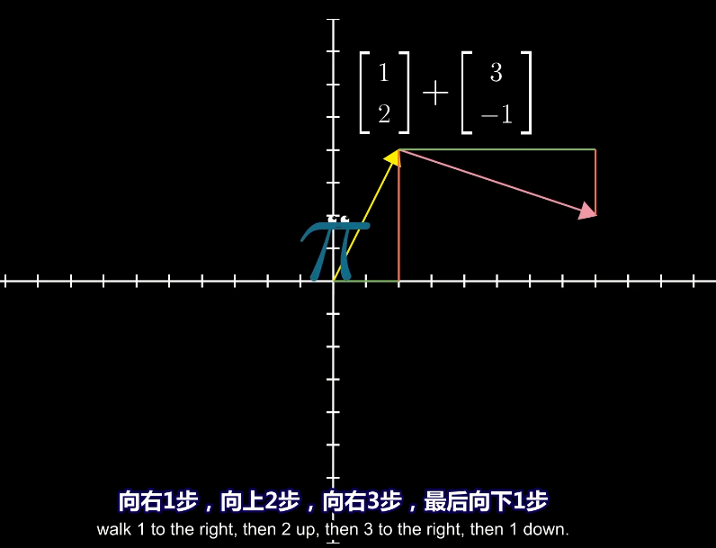
SVD分解

Slide 4
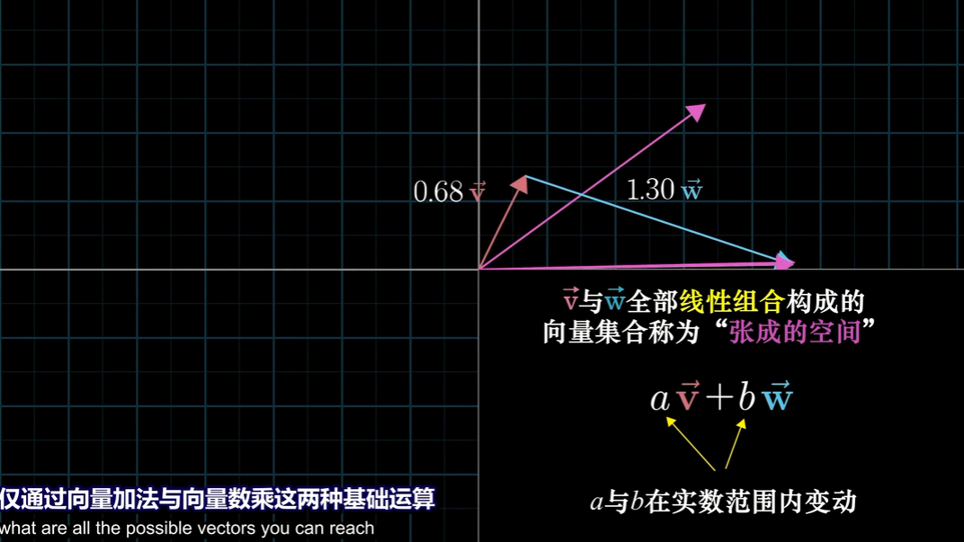
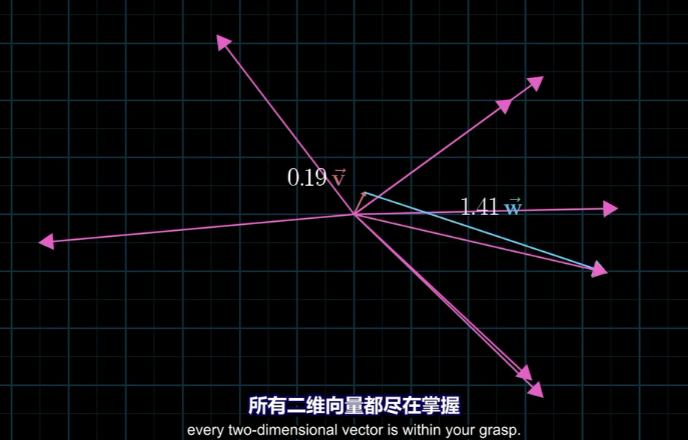

Slide 5


Slide 14
PCA与LDA(线性判别分析)
原理、应用

Slide 15
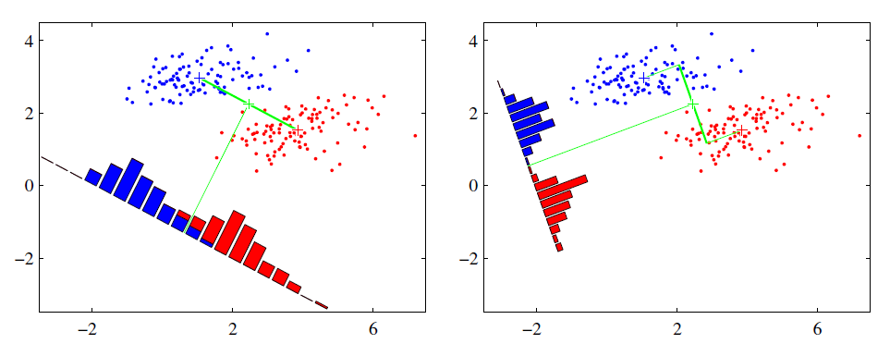
线性判别分析（Linear Discriminant Analysis）

Slide 16
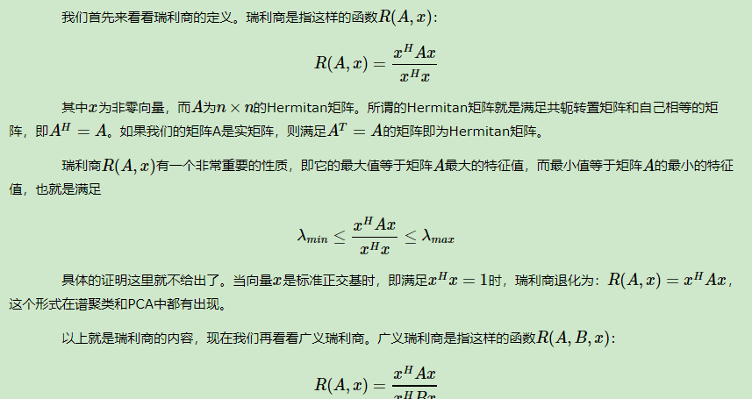
瑞利商
Notes:
https://www.cnblogs.com/pinard/p/6244265.html

Slide 17
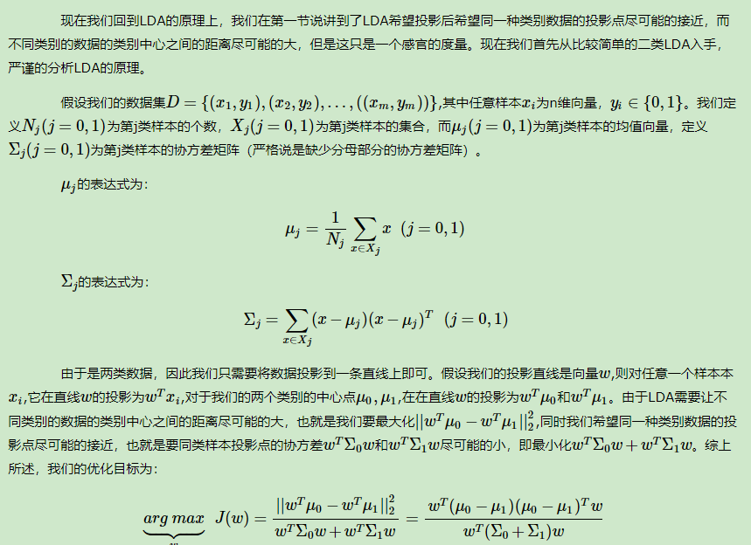

Slide 18
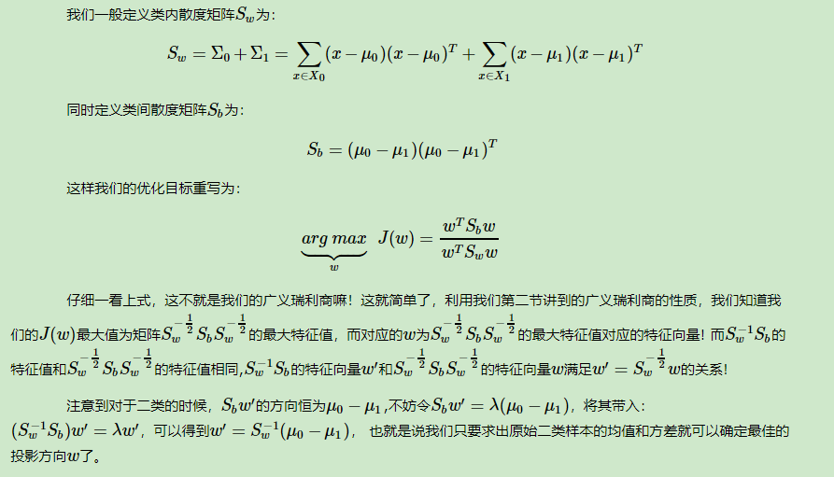
类内散度矩阵和类间散度矩阵

Slide 19
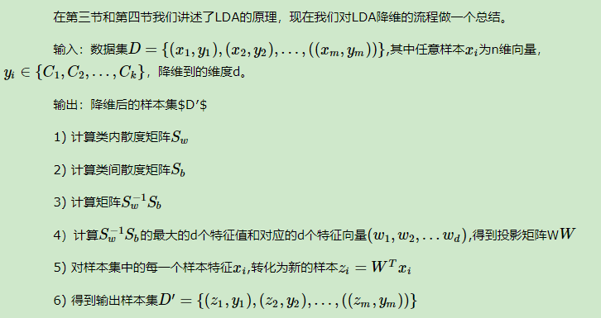
算法流程

Slide 20
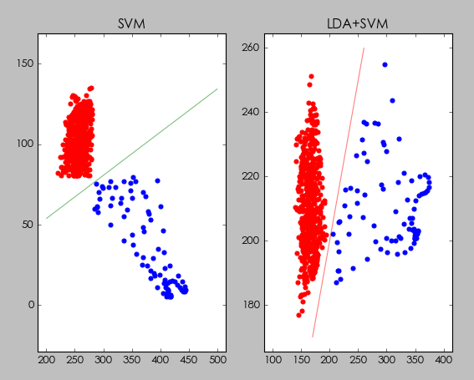
两种岩性在AC和GR属性下的SVM分类

Slide 21
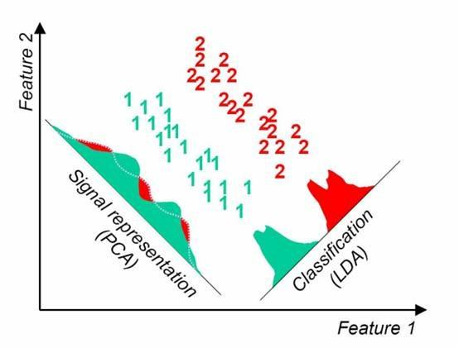
PCA VS LDA

Slide 22
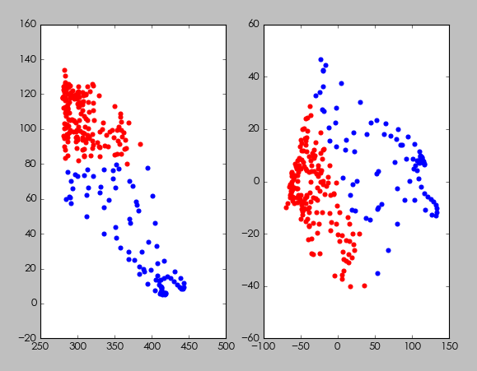
两种岩性,在AC和GR属性上做PCA

Slide 23
def pca_fit(n_componets, X): X = X - X.mean(0) m, n = X.shape # 求协方差矩阵 n*n cov_=np.cov(X.T) # 求协方差矩阵的特征值、特征向量 eig_value, eig_vector = np.linalg.eig(cov_) print('eig_value.shape：', eig_value.shape, 'eig_vector.shape：', eig_vector.shape, ) # m,n * n 当n>>m时候，可以先求m*m的特征向量，再反过来求n*nd得特征矩阵 #eig_vector = np.dot(X.T, eig_vector) eigValInd = np.argsort(-eig_value) # 对特征值eigVals从小到大排序 eigValInd = eigValInd[:(n_componets + 1)] # 从排好序的特征值，从后往前取k个，这样就实现了特征值的从大到小排列 redEigVects = np.matrix(eig_vector).T[:, eigValInd] # 返回排序后特征值对应的特征向量redEigVects（主成分） #有可能是不是实数 real_redEigVects = np.real(redEigVects) return real_redEigVects def pca_transform(X, eig_vectors): X = X - X.mean(0) return eig_vectors*X.T
基于特征值分解的PCA核心代码

Slide 24
基于特征值分解的LDA核心代码
def LinearDA_multi(X,y): ys=np.unique(y) dim=X.shape[1] # 类内散度矩阵 Sw Sw=np.zeros((dim,dim)) Sb=np.zeros((dim,dim)) x_mean=X.mean(0) for y_ in ys: y0_index =y==y_ X0=X[y0_index] n=len(X0) Sw+=np.cov(X0.T)*(n-1) x0_mean=X0.mean(0) Sb+=len(X0)*np.dot(np.matrix((x0_mean-x_mean)).T,np.matrix(x0_mean-x_mean)) eig_values,eig_vectors=eig(np.dot(inv(Sw),Sb)) return (eig_values,eig_vectors)

Slide 25
数学中的向量和计算机中的向量

Slide 26
矩阵分解
QR分解、SVD分解

Slide 31
人脸识别应用

Slide 32
实验方案一：PCA+SVM（特征脸方法）
训练样本
测试样本
数据预处理
PCA(n=200)
test
训练好的SVM
train
线性SVM
结果分析

Slide 33
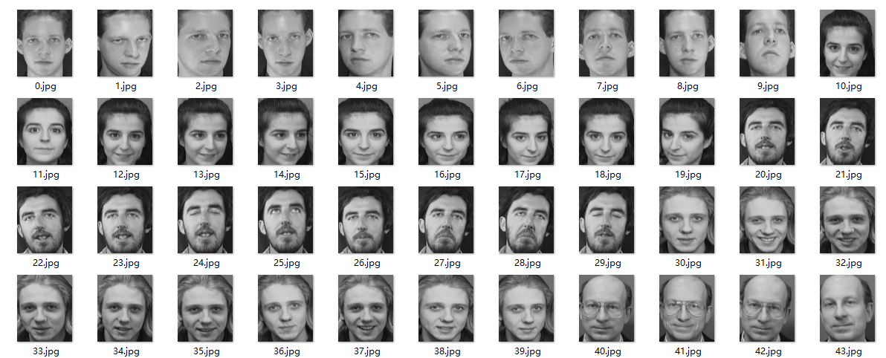
ORL人脸图像库：400张人脸，每人共10张，40个人

Slide 34
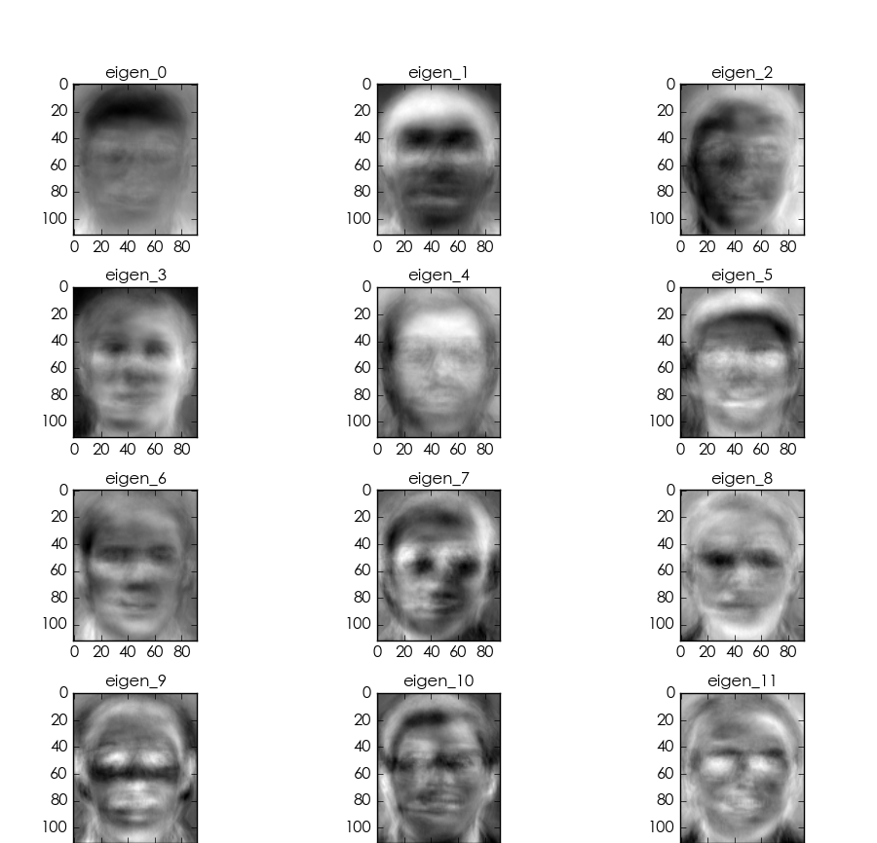

20%的轮廓来自1，5%的轮廓来自2，2%的轮廓来自3….
这张图像可能由很多特征脸(特征向量)部分组成，PCA抽出最主要的部分

Slide 35


Slide 36
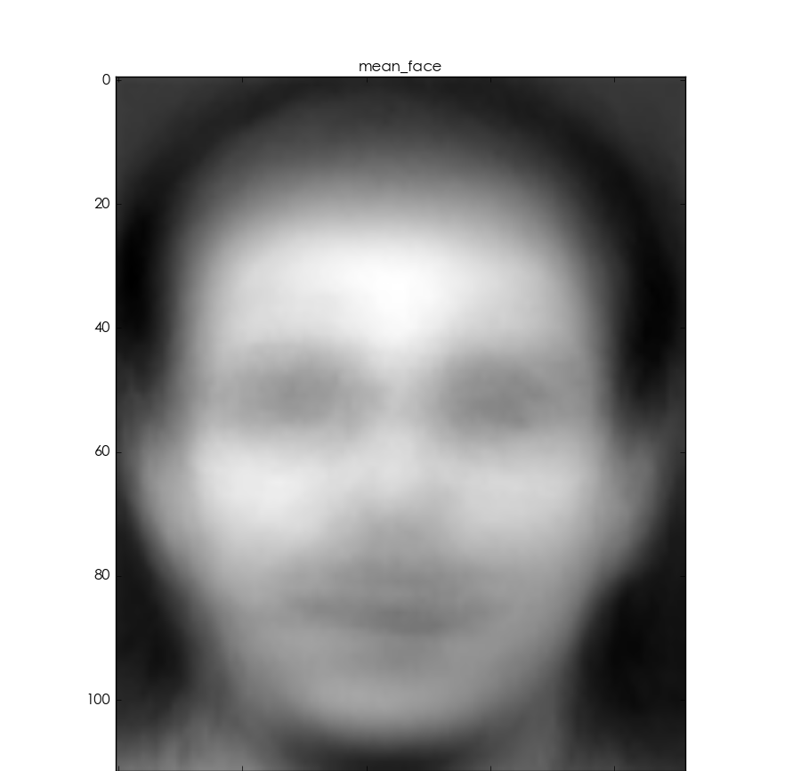

Slide 37
0.50727203431

Slide 38
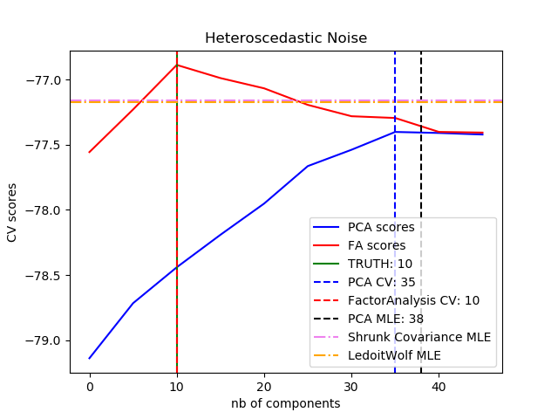

Slide 39
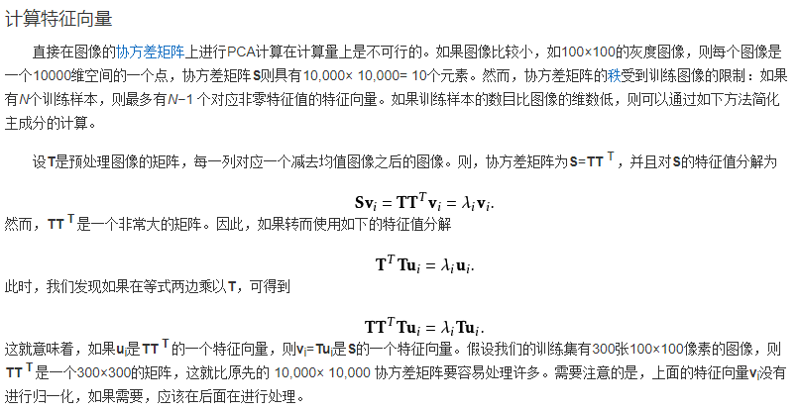
计算特征脸的一些技巧

Slide 40
实验方案二：PCA+LDA（Fisher判别方法）
训练样本
测试样本
数据预处理
LDA(n=200)
test
训练好的SVM
train
线性SVM
结果分析

Slide 41
metircs result is :
precision recall f1-score support
0 0.57 1.00 0.73 4
1 1.00 1.00 1.00 3
2 1.00 0.33 0.50 3
3 1.00 1.00 1.00 4
4 1.00 1.00 1.00 3
5 1.00 1.00 1.00 3
6 1.00 1.00 1.00 2
7 1.00 0.57 0.73 7
8 0.67 1.00 0.80 2
9 1.00 1.00 1.00 3
10 0.33 1.00 0.50 1
11 1.00 1.00 1.00 5
12 1.00 1.00 1.00 1
13 1.00 1.00 1.00 1
14 1.00 1.00 1.00 2
15 1.00 1.00 1.00 2
17 1.00 1.00 1.00 2
18 1.00 1.00 1.00 3
19 1.00 1.00 1.00 3
20 1.00 0.50 0.67 2
21 1.00 1.00 1.00 1
22 1.00 1.00 1.00 2
23 1.00 1.00 1.00 2
24 1.00 1.00 1.00 1
25 1.00 1.00 1.00 2
26 1.00 1.00 1.00 1
27 1.00 1.00 1.00 2
28 1.00 1.00 1.00 4
29 1.00 1.00 1.00 1
30 1.00 1.00 1.00 3
31 1.00 1.00 1.00 3
32 1.00 1.00 1.00 2
33 1.00 1.00 1.00 2
35 1.00 1.00 1.00 3
36 1.00 1.00 1.00 2
37 1.00 1.00 1.00 1
38 1.00 1.00 1.00 4
39 1.00 1.00 1.00 5
40 1.00 1.00 1.00 6
avg / total 0.97 0.94 0.94 103

Slide 42
实验方案二：VGG16
训练样本
测试样本
数据预处理
test
训练好的VGG16
VGG16卷积层（冻结前15层）
train
2层全连接层
结果分析

Slide 43
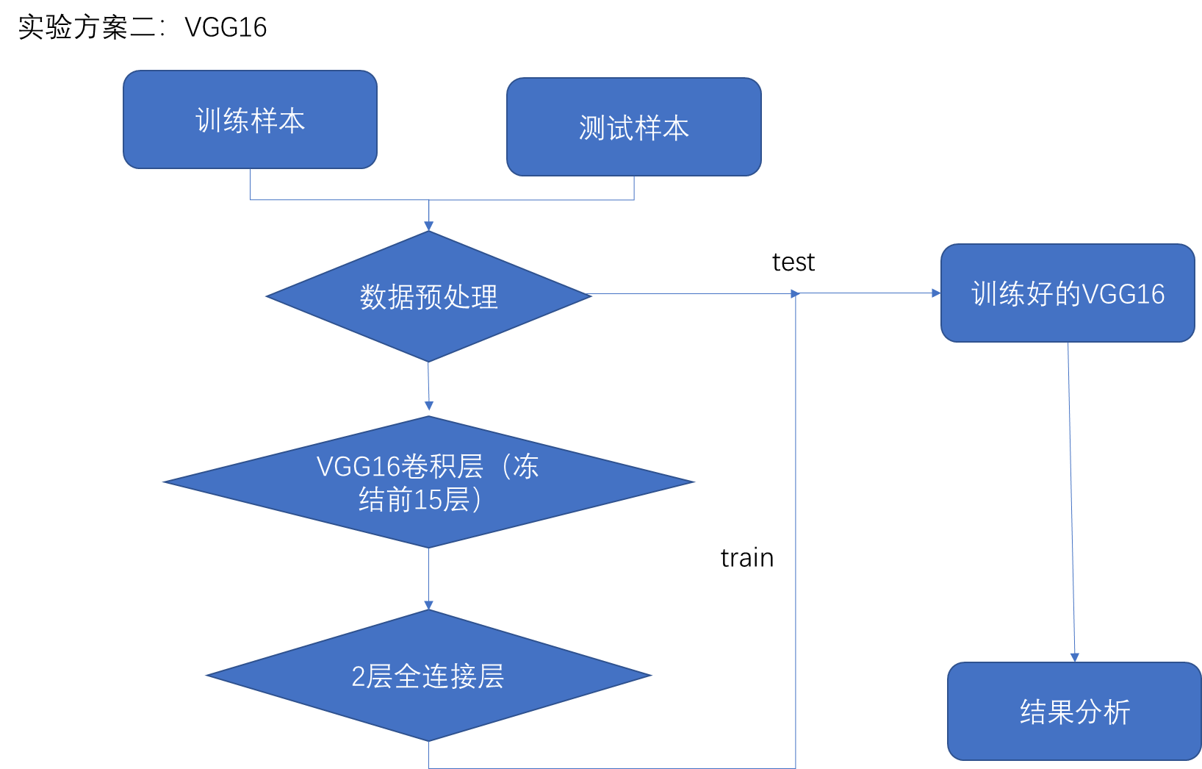
_________________________________________________________________ Layer (type) Output Shape Param # ================================================================= input_1 (InputLayer) (None, 250, 250, 3) 0 _________________________________________________________________ block1_conv1 (Conv2D) (None, 250, 250, 64) 1792 _________________________________________________________________ block1_conv2 (Conv2D) (None, 250, 250, 64) 36928 _________________________________________________________________ block1_pool (MaxPooling2D) (None, 125, 125, 64) 0 _________________________________________________________________ block2_conv1 (Conv2D) (None, 125, 125, 128) 73856 _________________________________________________________________ block2_conv2 (Conv2D) (None, 125, 125, 128) 147584 _________________________________________________________________ block2_pool (MaxPooling2D) (None, 62, 62, 128) 0 _________________________________________________________________ block3_conv1 (Conv2D) (None, 62, 62, 256) 295168 _________________________________________________________________ block3_conv2 (Conv2D) (None, 62, 62, 256) 590080 _________________________________________________________________ block3_conv3 (Conv2D) (None, 62, 62, 256) 590080 _________________________________________________________________ block3_pool (MaxPooling2D) (None, 31, 31, 256) 0 _________________________________________________________________ block4_conv1 (Conv2D) (None, 31, 31, 512) 1180160 _________________________________________________________________ block4_conv2 (Conv2D) (None, 31, 31, 512) 2359808 _________________________________________________________________ block4_conv3 (Conv2D) (None, 31, 31, 512) 2359808 _________________________________________________________________ block4_pool (MaxPooling2D) (None, 15, 15, 512) 0 _________________________________________________________________ block5_conv1 (Conv2D) (None, 15, 15, 512) 2359808 _________________________________________________________________ block5_conv2 (Conv2D) (None, 15, 15, 512) 2359808 _________________________________________________________________ block5_conv3 (Conv2D) (None, 15, 15, 512) 2359808 _________________________________________________________________ block5_pool (MaxPooling2D) (None, 7, 7, 512) 0 _________________________________________________________________ sequential_1 (Sequential) (None, 500) 12795000 =================================================================

Slide 44
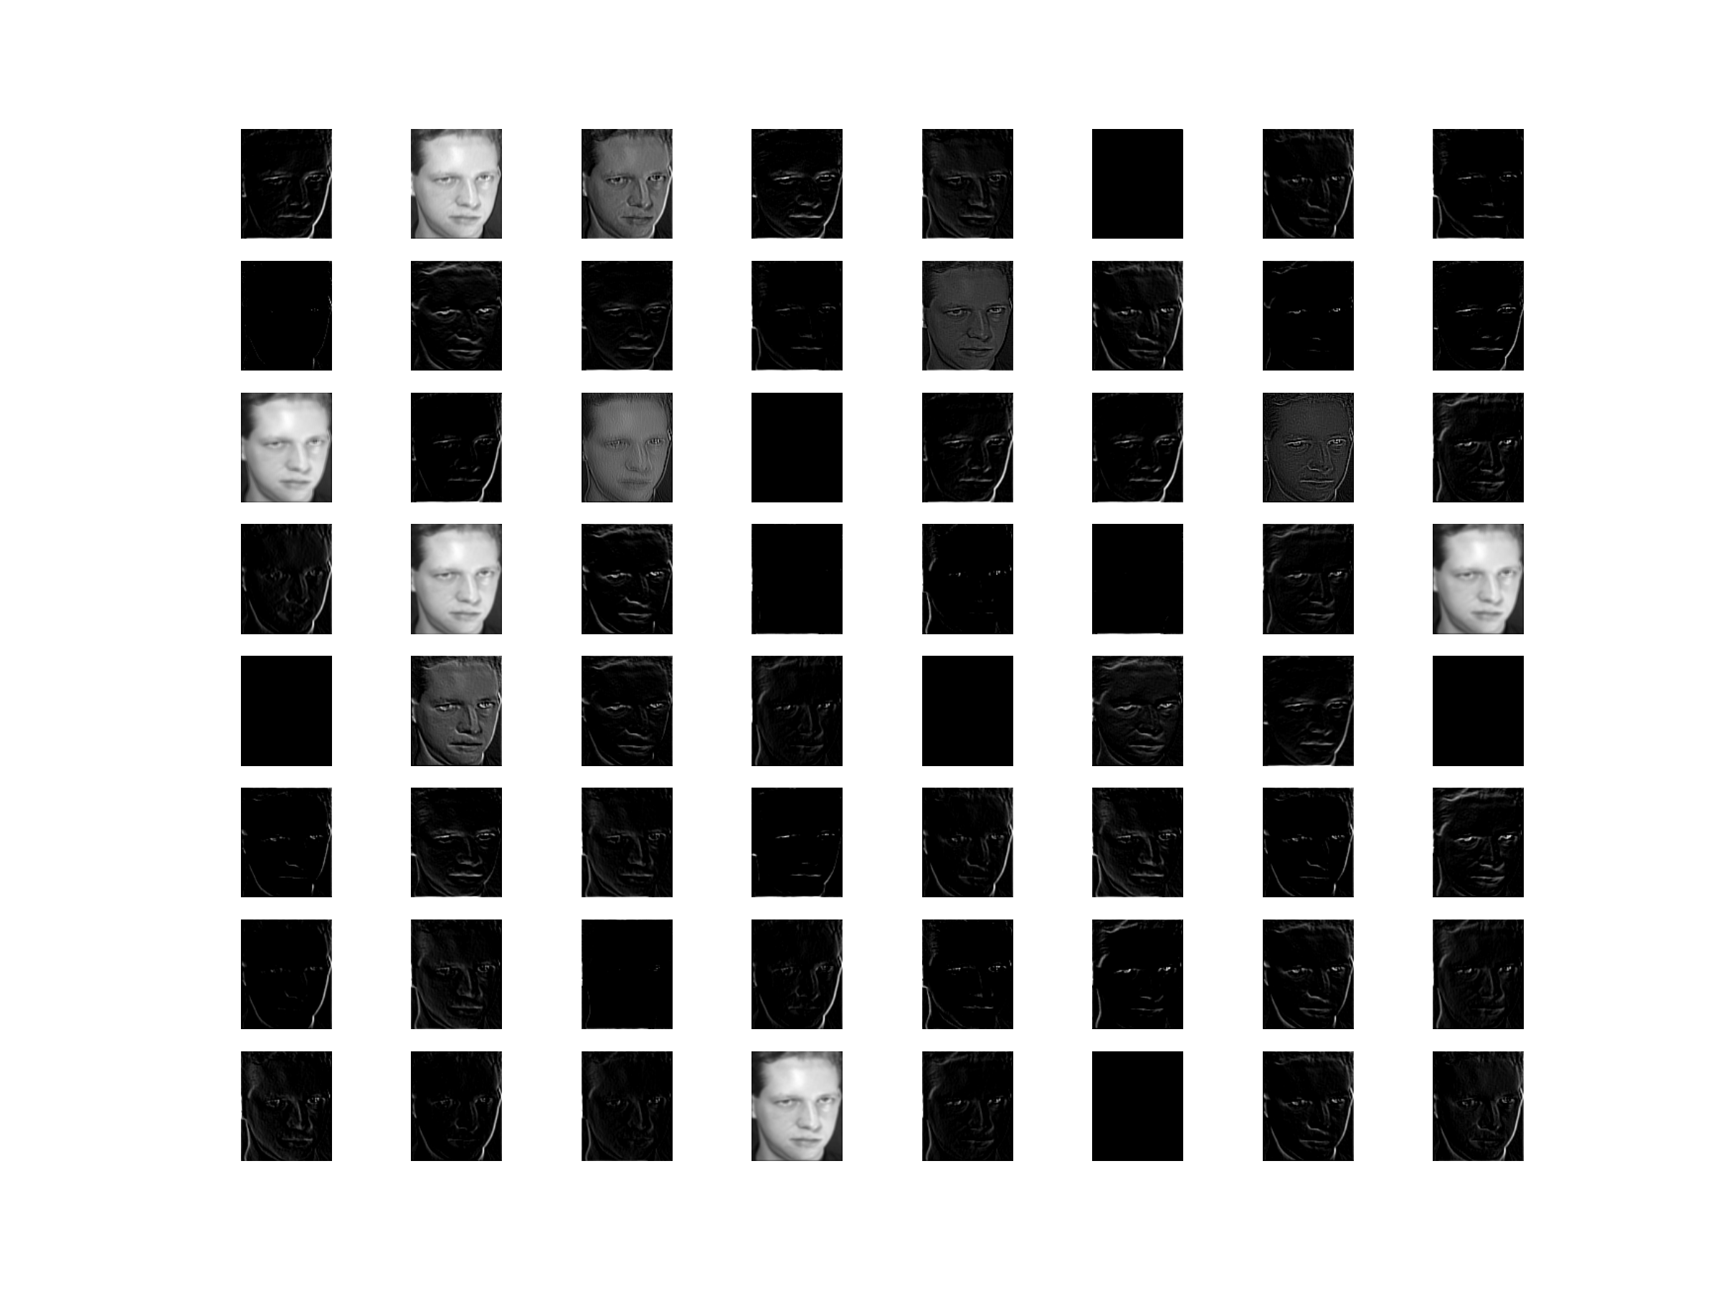
1

Slide 45
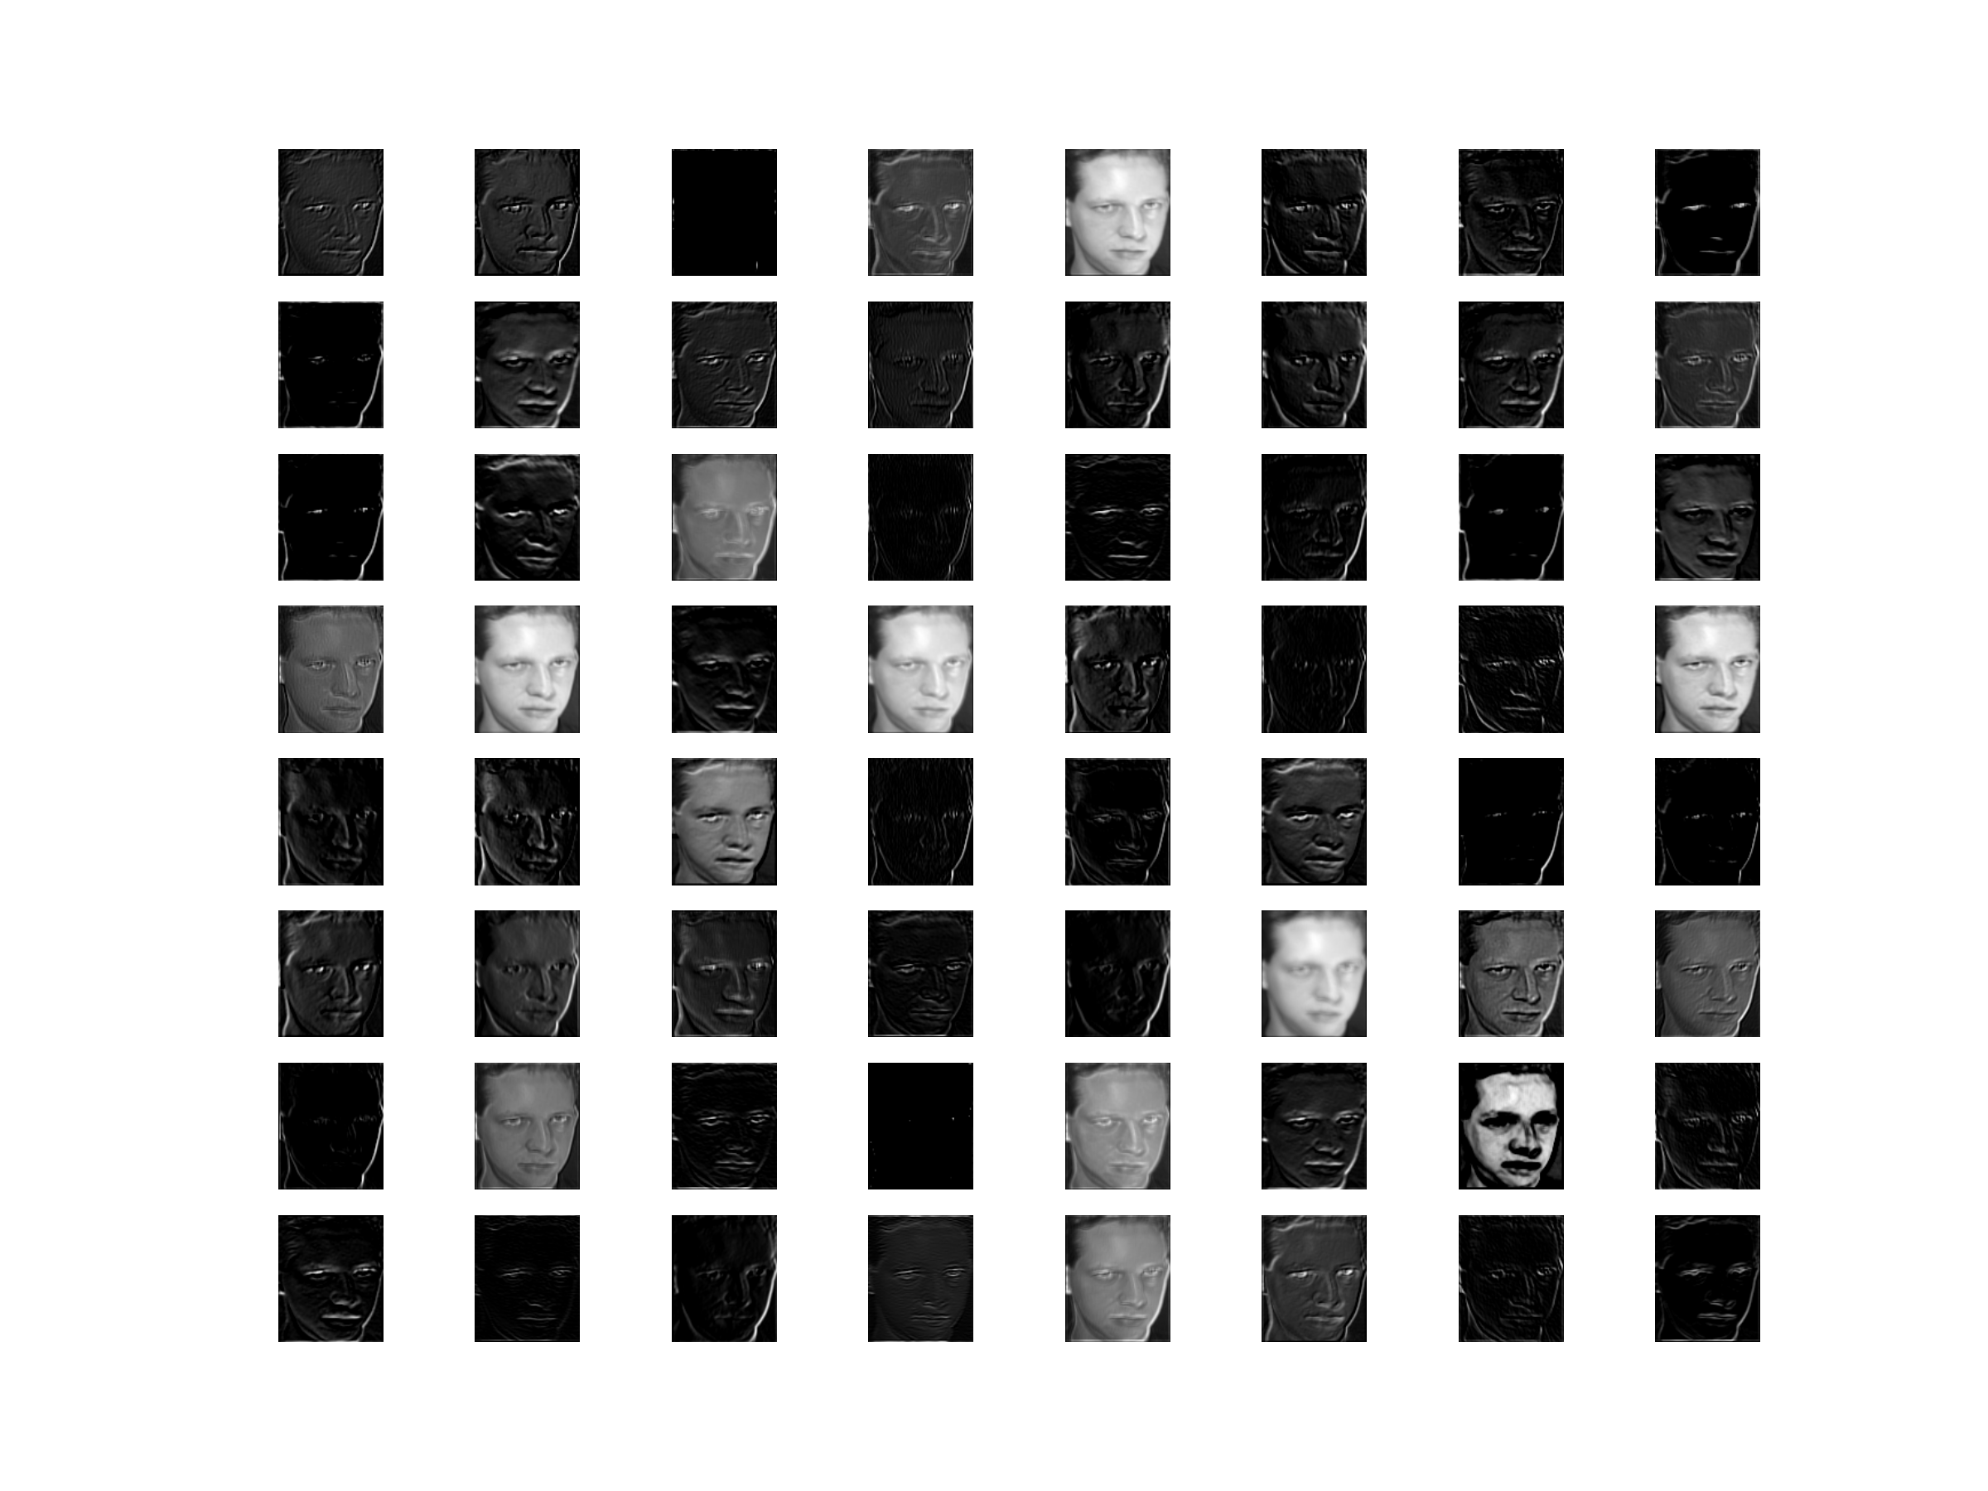
2

Slide 46
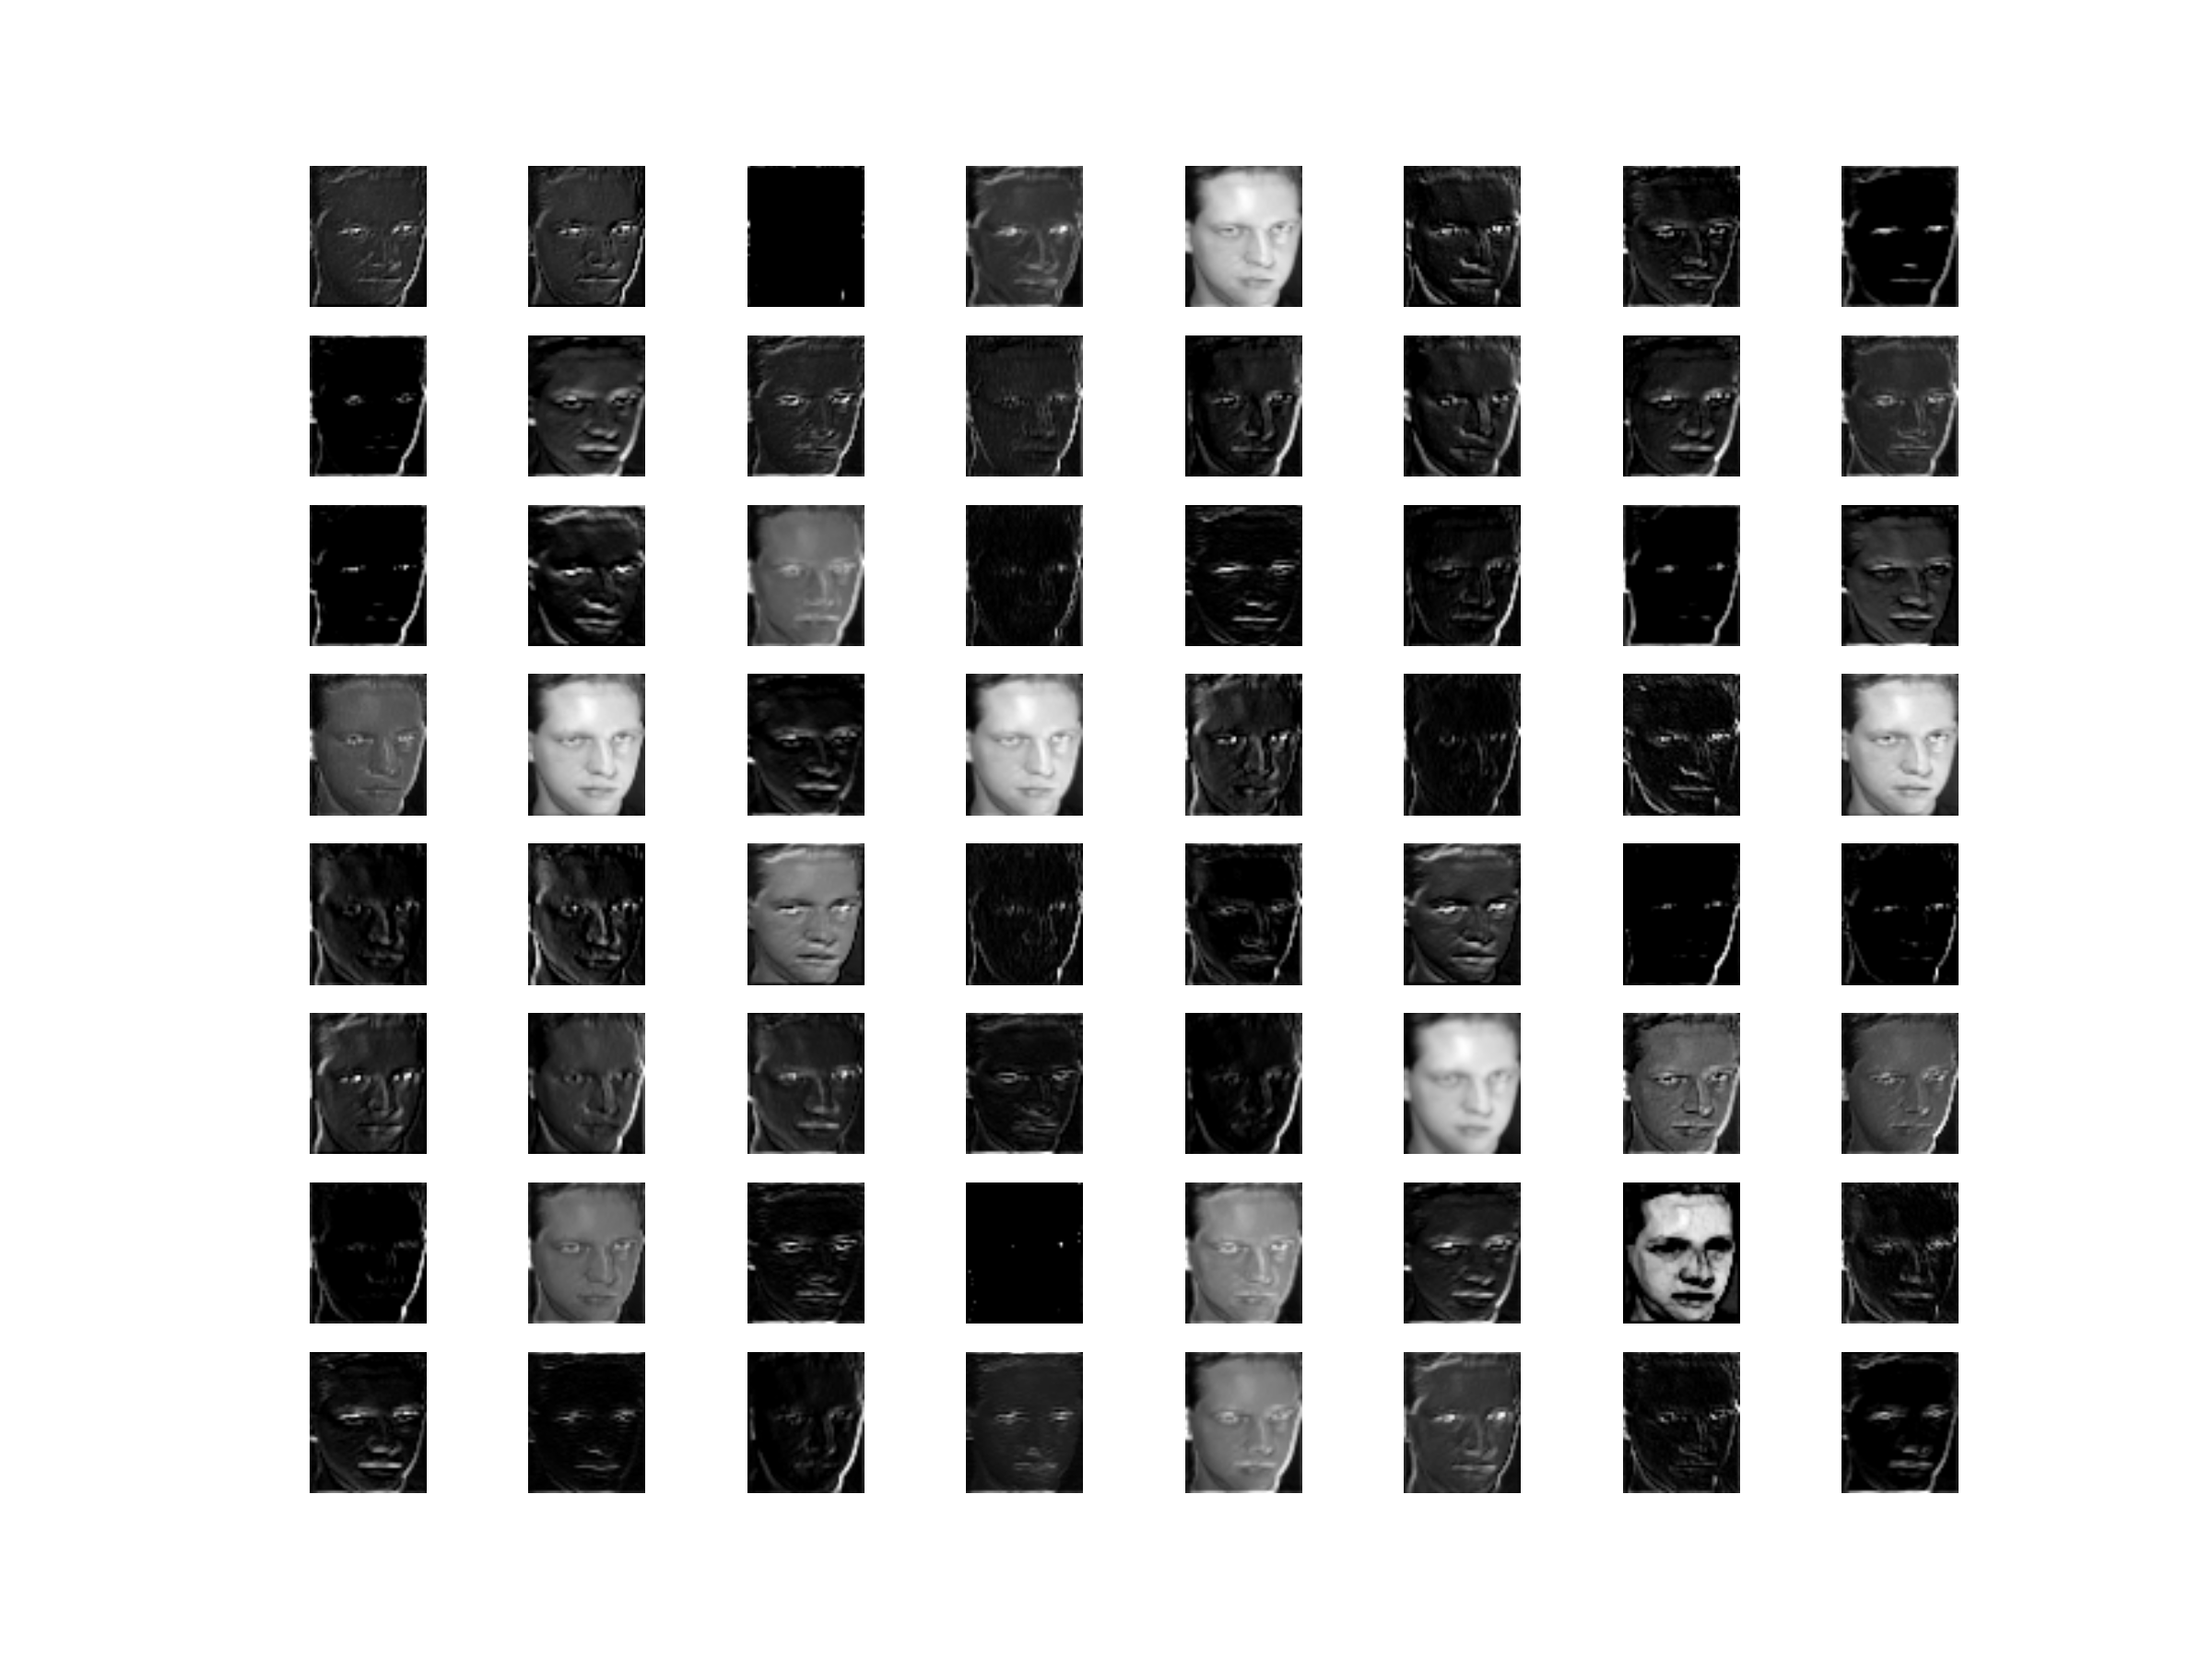
3

Slide 47
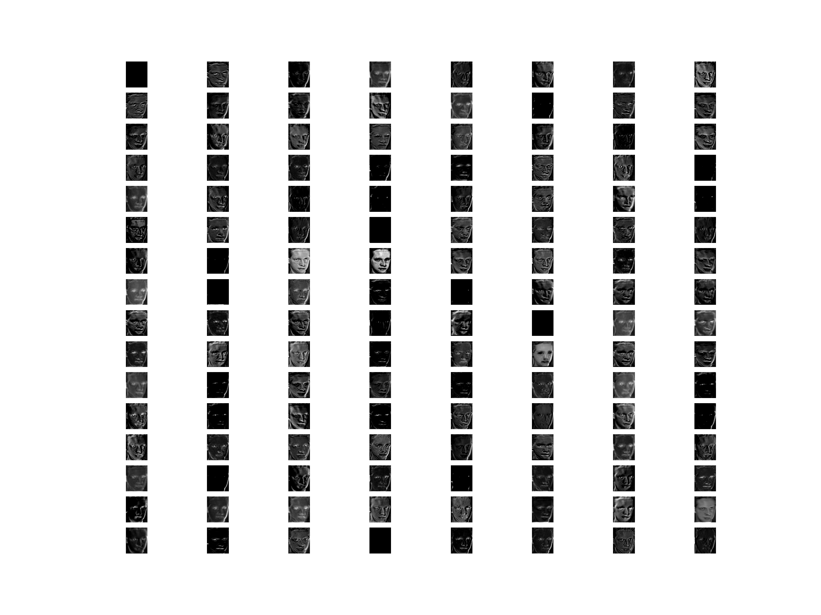
4

Slide 48
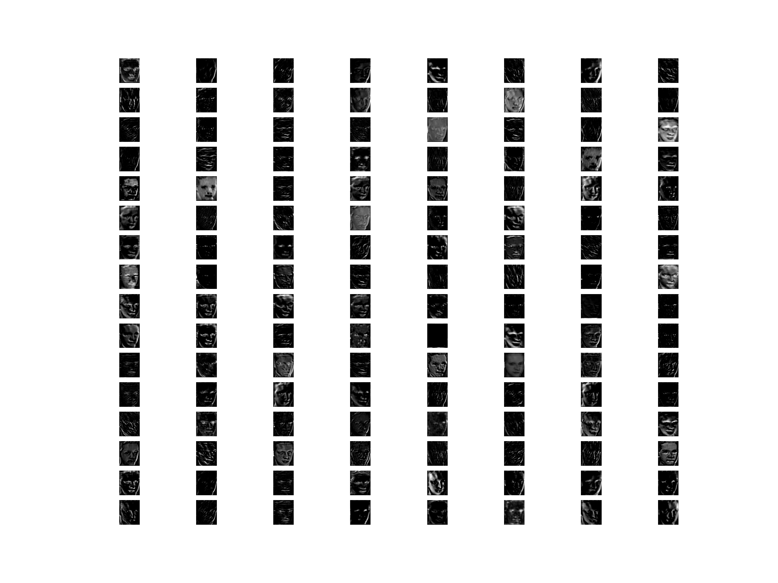
5

Slide 49

6

Slide 50
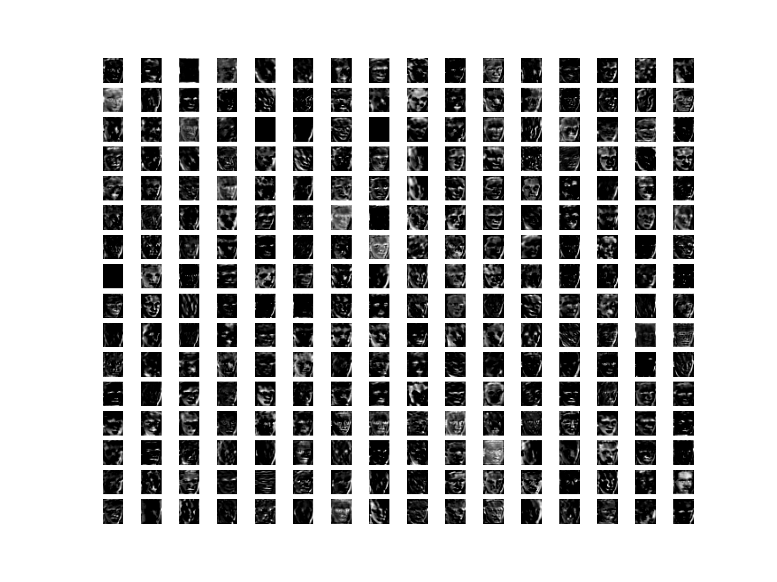
7

Slide 51
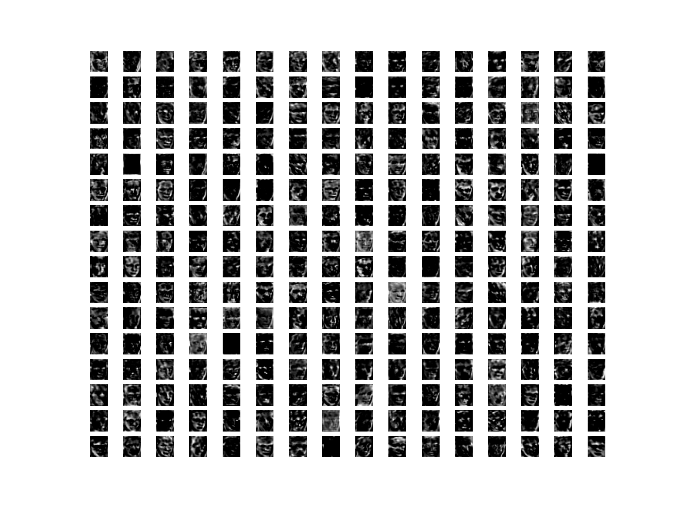
8

Slide 52
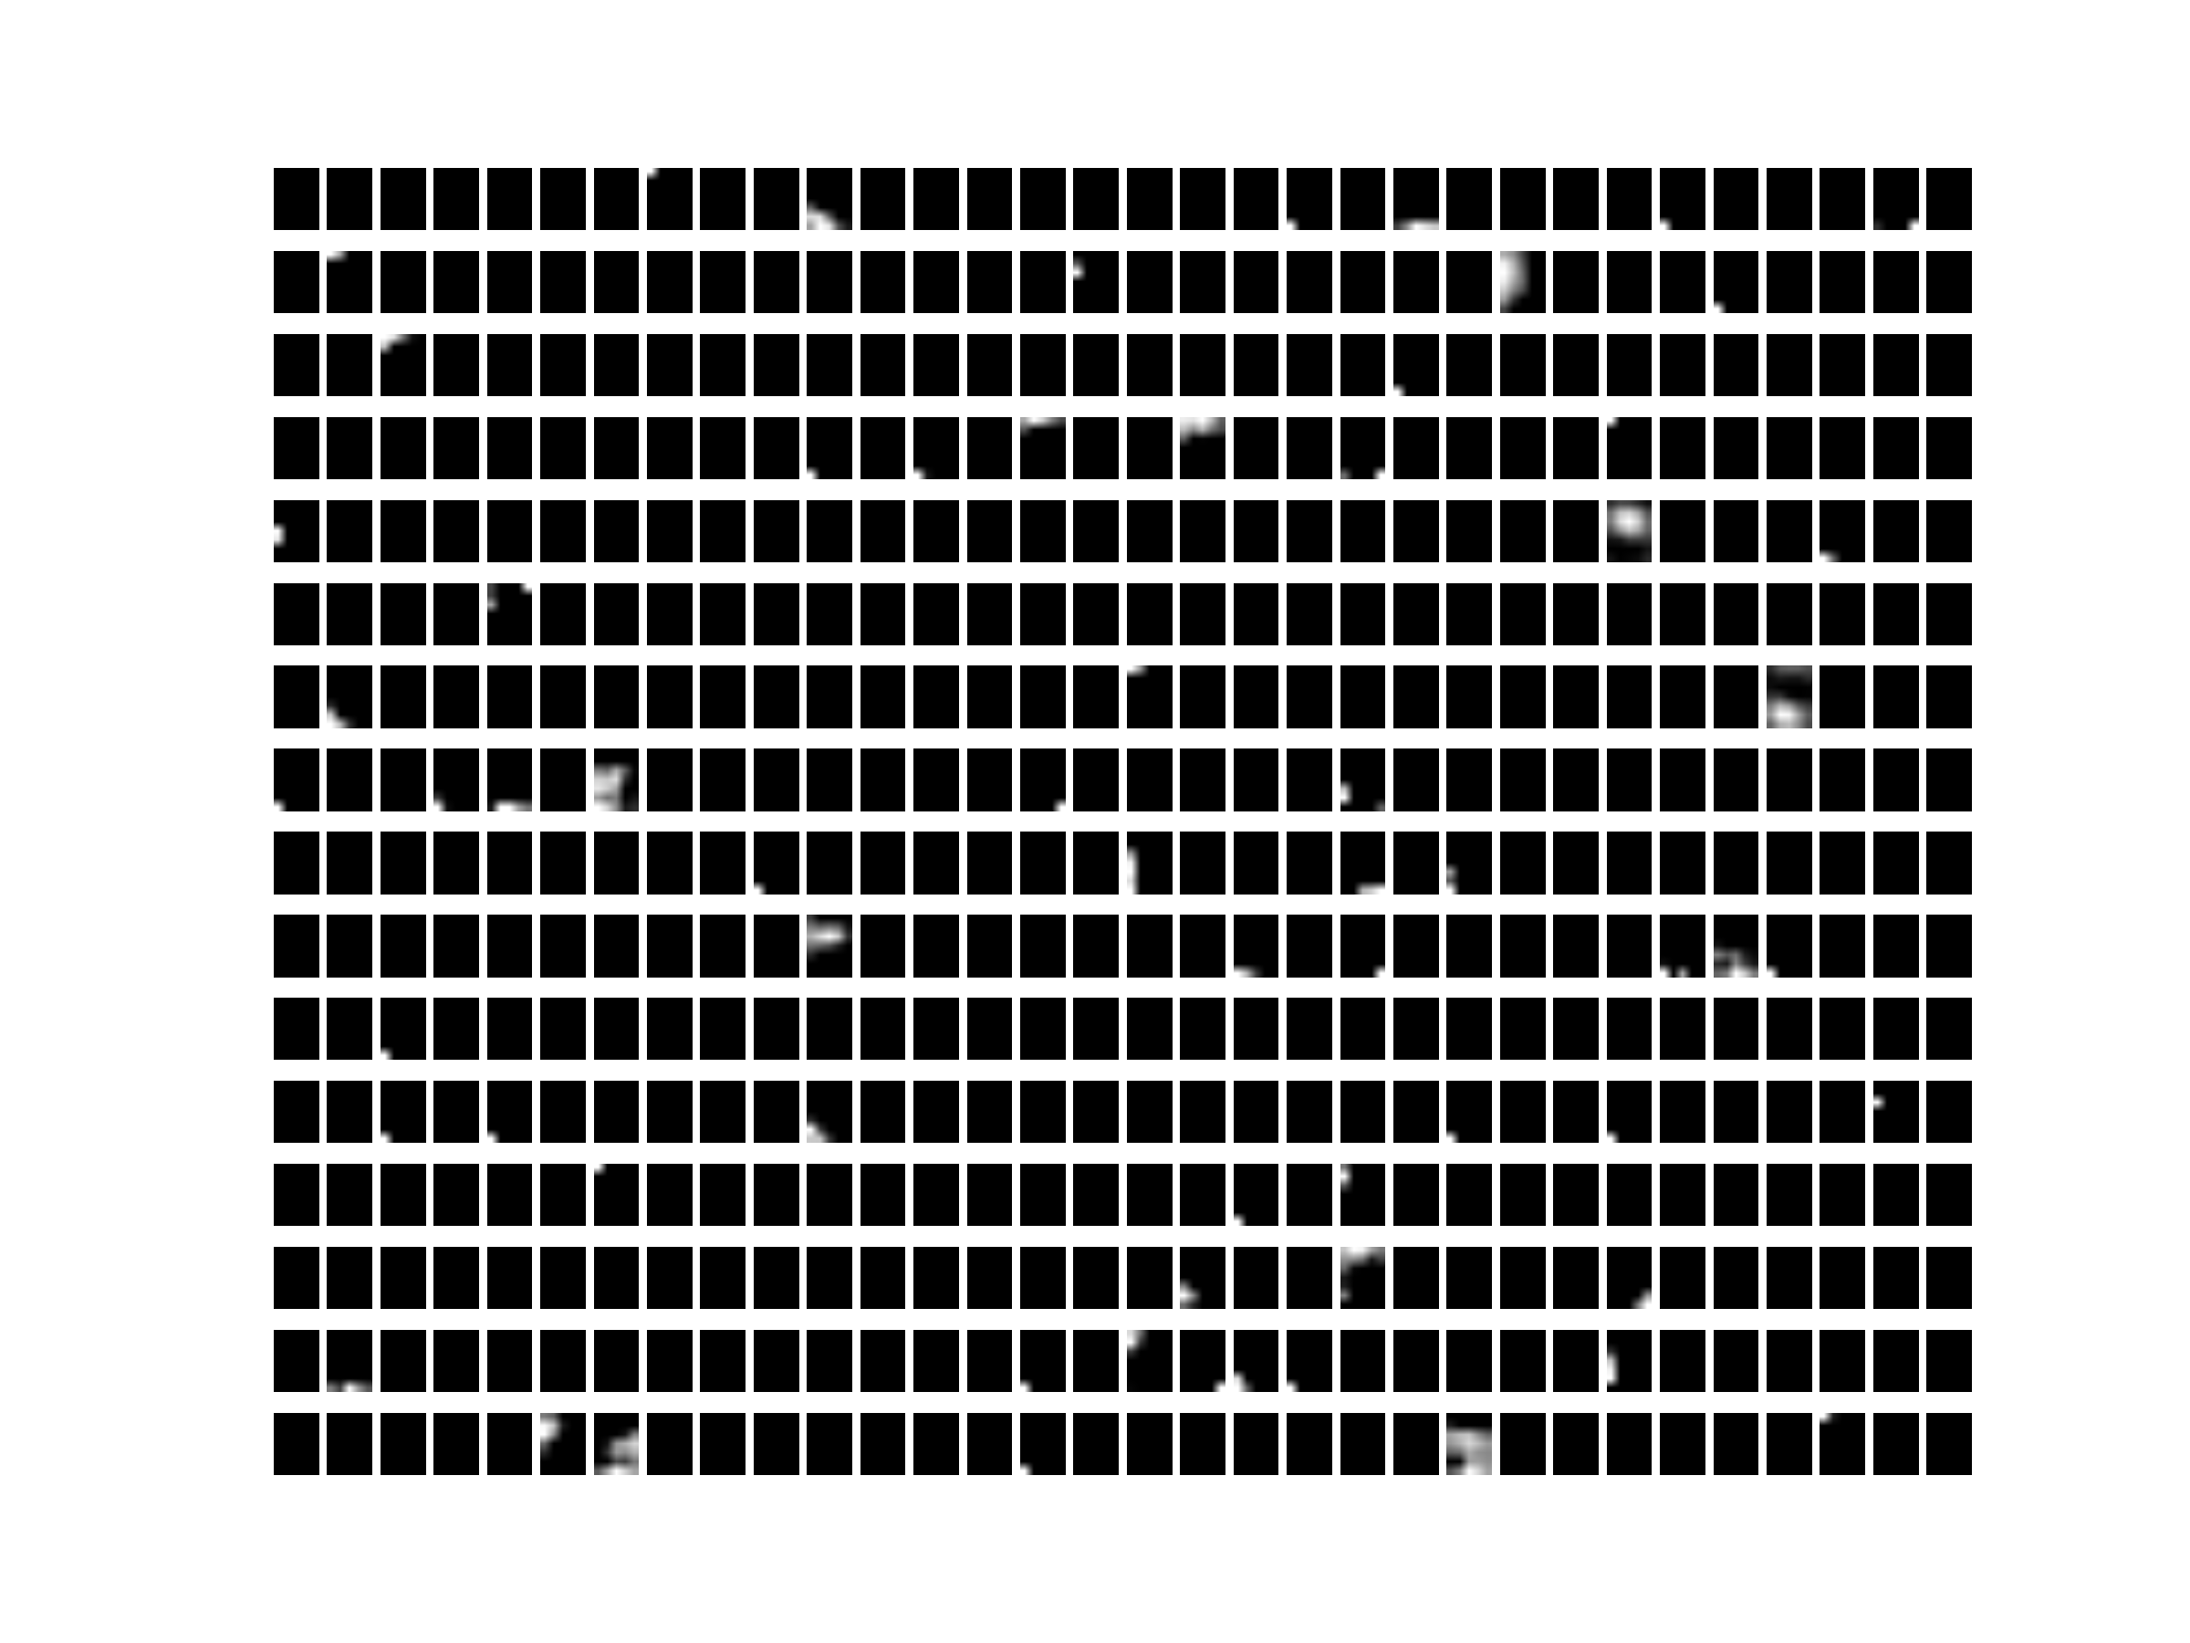
17

Slide 53
32/320 [==>...........................] - ETA: 3:09 - loss: 0.8151 - acc: 0.5070
64/320 [=====>........................] - ETA: 2:56 - loss: 0.7828 - acc: 0.5172
96/320 [========>.....................] - ETA: 2:33 - loss: 0.7478 - acc: 0.5398
128/320 [===========>..................] - ETA: 2:10 - loss: 0.7180 - acc: 0.5641
160/320 [==============>...............] - ETA: 1:46 - loss: 0.6937 - acc: 0.5886
192/320 [=================>............] - ETA: 1:23 - loss: 0.6728 - acc: 0.6060
224/320 [====================>.........] - ETA: 1:03 - loss: 0.6530 - acc: 0.6212
256/320 [=======================>......] - ETA: 42s - loss: 0.6334 - acc: 0.6383
288/320 [==========================>...] - ETA: 21s - loss: 0.6139 - acc: 0.6546
320/320 [==============================] - 264s 824ms/step - loss: 0.5963 - acc: 0.6695 –
val_loss: 0.2750 - val_acc: 0.9419
Epoch 2/10
32/320 [==>...........................] - ETA: 3:33 - loss: 0.4144 - acc: 0.8094
64/320 [=====>........................] - ETA: 3:17 - loss: 0.4051 - acc: 0.8125
96/320 [========>.....................] - ETA: 2:47 - loss: 0.3952 - acc: 0.8190
128/320 [===========>..................] - ETA: 2:21 - loss: 0.3894 - acc: 0.8273
160/320 [==============>...............] - ETA: 1:56 - loss: 0.3833 - acc: 0.8325
192/320 [=================>............] - ETA: 1:31 - loss: 0.3707 - acc: 0.8418
224/320 [====================>.........] - ETA: 1:08 - loss: 0.3567 - acc: 0.8489
256/320 [=======================>......] - ETA: 45s - loss: 0.3482 - acc: 0.8555
288/320 [==========================>...] - ETA: 22s - loss: 0.3399 - acc: 0.8613
320/320 [==============================] - 276s 862ms/step - loss: 0.3294 - acc: 0.8668 –
测试集合 val_loss: 0.1249 - val_acc: 0.9750

Slide 54
PCA+SVM | LDA+SVM | VGG16
0.77 | 0.97 | 0.975

Slide 55
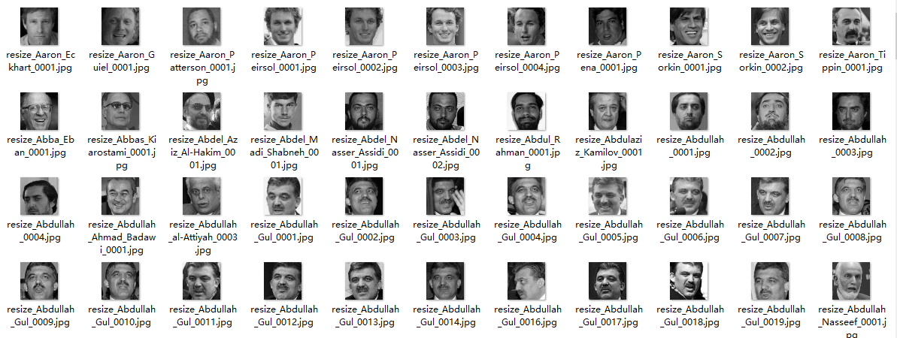
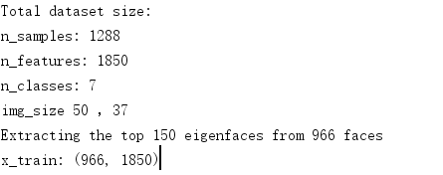
LFW

Slide 56
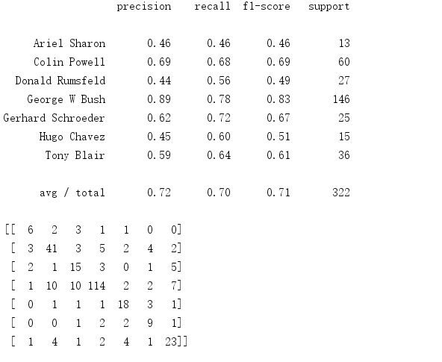
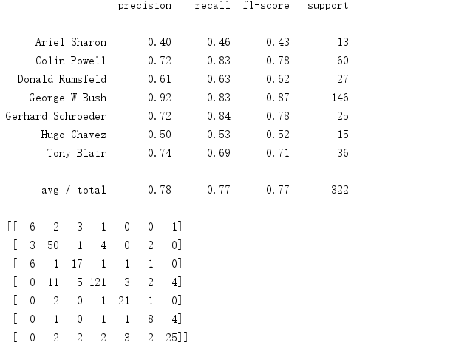
PCA+径向基SVM
PCA+线性SVM

Slide 57
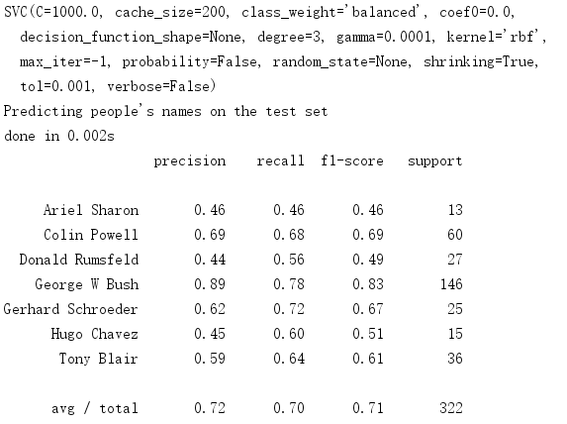
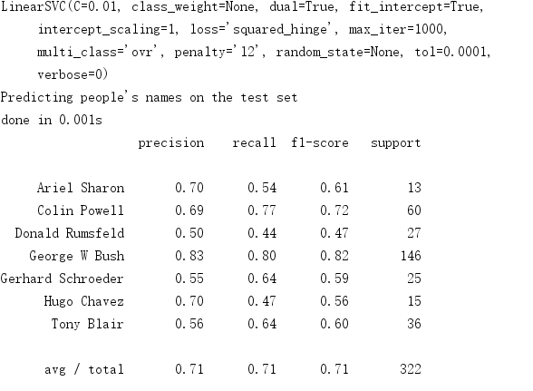
LDA+径向基SVM
LDA+线性SVM

Slide 58
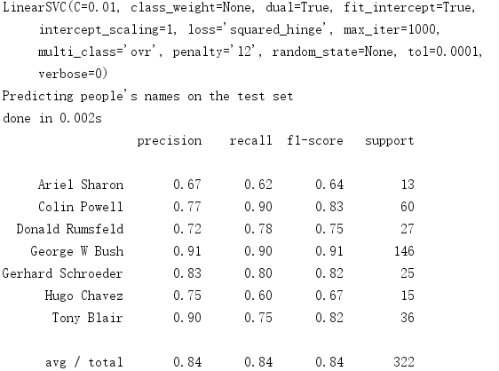
参数调优后的结果(LDA)
参数调优后的结果(PCA)

Slide 59
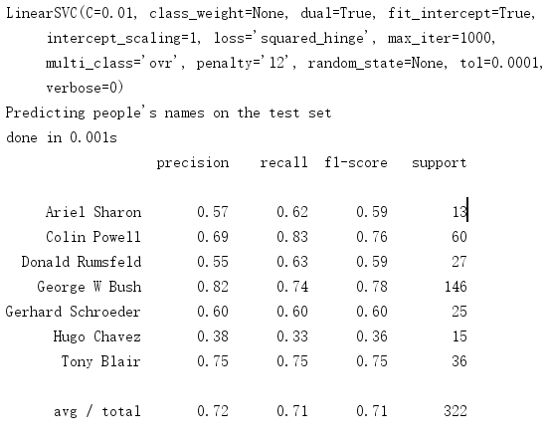

经过LBP处理的图像的再进行降维的结果，由于图像变化均匀，并没有太大的光照影响，LBP同时损失了一些信息，准确率有些下降
LDA+SVM
PCA+SVM

Slide 60
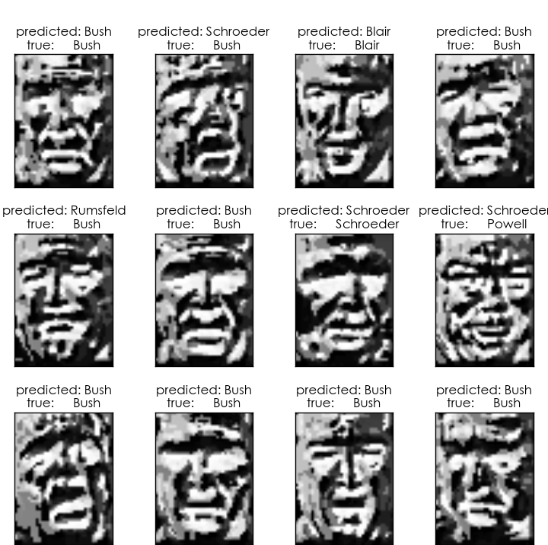

Slide 61
32/1156 [..............................] - ETA: 58:33 - loss: 0.6909 - acc: 0.9510
64/1156 [>.............................] - ETA: 56:31 - loss: 0.6909 - acc: 0.9505
96/1156 [=>............................] - ETA: 55:14 - loss: 0.6908 - acc: 0.9504
128/1156 [==>...........................] - ETA: 53:26 - loss: 0.6908 - acc: 0.9508
160/1156 [===>..........................] - ETA: 51:50 - loss: 0.6908 - acc: 0.9510
192/1156 [===>..........................] - ETA: 50:00 - loss: 0.6907 - acc: 0.9506
224/1156 [====>.........................] - ETA: 48:14 - loss: 0.6907 - acc: 0.9501
256/1156 [=====>........................] - ETA: 46:31 - loss: 0.6906 - acc: 0.9494
288/1156 [======>.......................] - ETA: 44:51 - loss: 0.6906 - acc: 0.9494
320/1156 [=======>......................] - ETA: 43:18 - loss: 0.6905 - acc: 0.9491
352/1156 [========>.....................] - ETA: 41:55 - loss: 0.6905 - acc: 0.9487
384/1156 [========>.....................] - ETA: 40:14 - loss: 0.6904 - acc: 0.9485
416/1156 [=========>....................] - ETA: 38:35 - loss: 0.6904 - acc: 0.9482
448/1156 [==========>...................] - ETA: 36:59 - loss: 0.6904 - acc: 0.9482
480/1156 [===========>..................] - ETA: 35:39 - loss: 0.6903 - acc: 0.9479
512/1156 [============>.................] - ETA: 34:33 - loss: 0.6903 - acc: 0.9477
544/1156 [=============>................] - ETA: 33:01 - loss: 0.6902 - acc: 0.9473
576/1156 [=============>................] - ETA: 31:29 - loss: 0.6902 - acc: 0.9470
608/1156 [==============>...............] - ETA: 29:44 - loss: 0.6901 - acc: 0.9469
640/1156 [===============>..............] - ETA: 28:11 - loss: 0.6901 - acc: 0.9467
672/1156 [================>.............] - ETA: 26:25 - loss: 0.6901 - acc: 0.9465
704/1156 [=================>............] - ETA: 24:41 - loss: 0.6900 - acc: 0.9463
736/1156 [==================>...........] - ETA: 22:55 - loss: 0.6900 - acc: 0.9461
768/1156 [==================>...........] - ETA: 21:10 - loss: 0.6899 - acc: 0.9459
800/1156 [===================>..........] - ETA: 19:24 - loss: 0.6899 - acc: 0.9457
832/1156 [====================>.........] - ETA: 17:43 - loss: 0.6898 - acc: 0.9455
864/1156 [=====================>........] - ETA: 16:03 - loss: 0.6898 - acc: 0.9453
896/1156 [======================>.......] - ETA: 14:18 - loss: 0.6897 - acc: 0.9451
928/1156 [=======================>......] - ETA: 12:31 - loss: 0.6897 - acc: 0.9449
960/1156 [=======================>......] - ETA: 10:45 - loss: 0.6897 - acc: 0.9448
992/1156 [========================>.....] - ETA: 9:00 - loss: 0.6896 - acc: 0.9446
1024/1156 [=========================>....] - ETA: 7:15 - loss: 0.6896 - acc: 0.9444
1056/1156 [==========================>...] - ETA: 5:29 - loss: 0.6895 - acc: 0.9443
1088/1156 [===========================>..] - ETA: 3:44 - loss: 0.6895 - acc: 0.9442
1120/1156 [============================>.] - ETA: 1:58 - loss: 0.6894 - acc: 0.9441
1152/1156 [============================>.] - ETA: 13s - loss: 0.6894 - acc: 0.9440
1156/1156 [==============================] - 3806s 3s/step - loss: 0.6894 - acc: 0.9440

